Slide 1
Privacy-Preserving Federated Learning Using
Homomorphic Encryption
使用同态加密进行隐私保护的联邦学习模型
汇报人：黄其涵
Park J, Lim H. Privacy-Preserving Federated Learning Using Homomorphic Encryption[J]. Applied Sciences, 2022, 12(2): 734.

Slide 2
Contents
01
Introduction
02
Methodology
03
Conclusion

Slide 3
01
Introduction

Slide 4
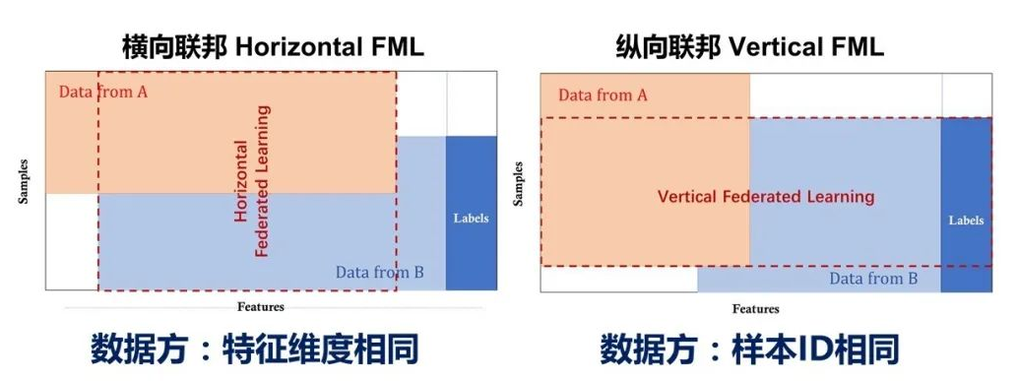
Introduction
1.1 Federated Learning

Slide 5
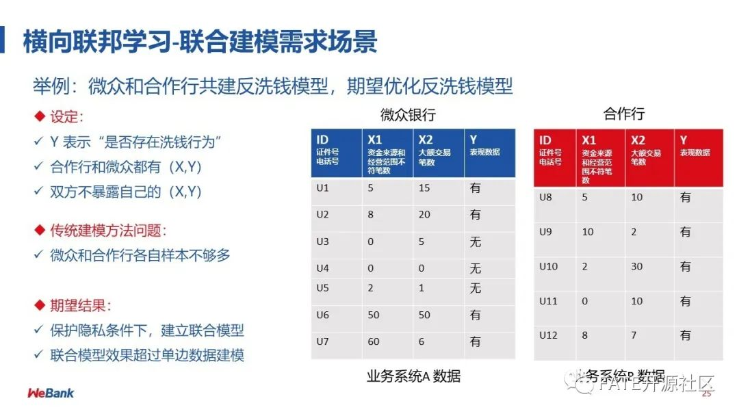
Introduction
1.1 Federated Learning

Slide 6
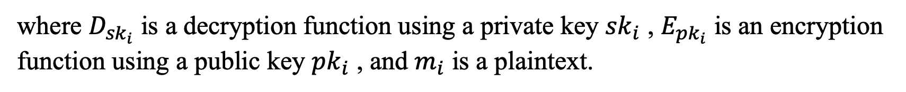
Introduction
1.2 Homomorphic encryption
Homomorphic encryption is a form of encryption that permits users to perform computations on its encrypted data without first decrypting it. For example, the property of the additive homomorphic encryption (AHE) scheme, which can only perform addition operations, is represented as follows in:
where $D_{{sk}_{i}}$ is a decryption function using a private key ${sk}_{i}$ , $E_{{pk}_{i}}$ is an encryption function using a public key ${pk}_{i}$ , and $m_{i}$ is a plaintext.

Slide 7
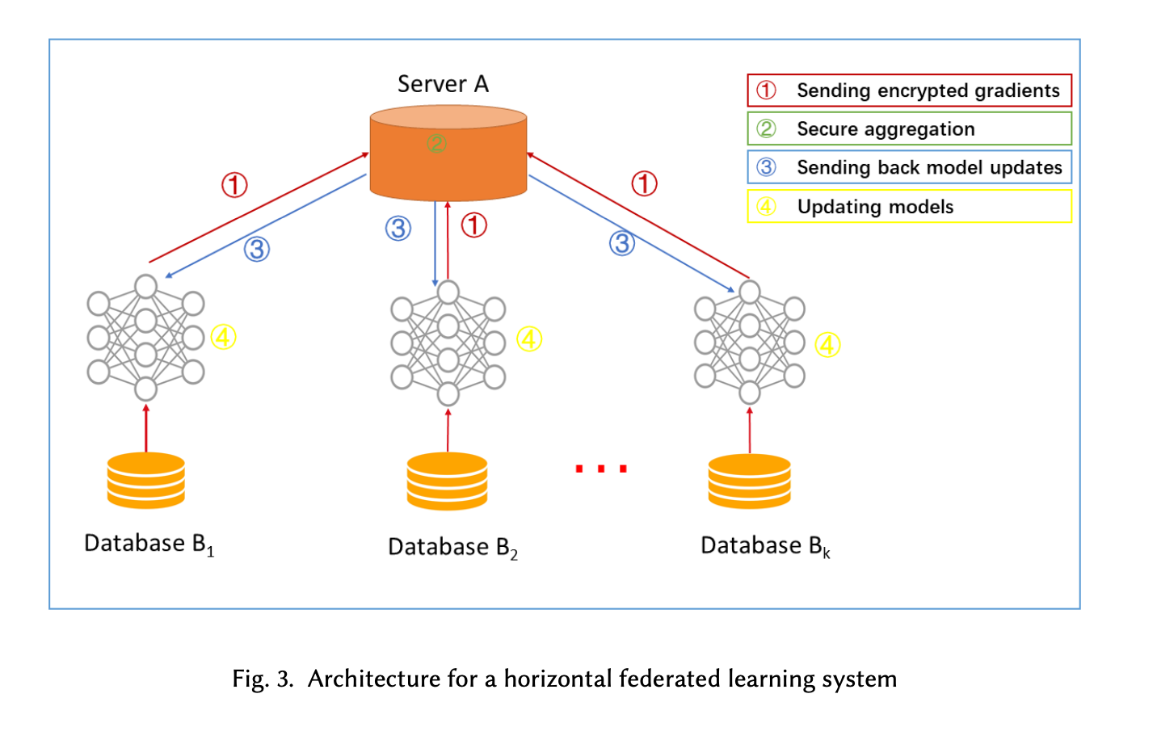
Introduction
1.1 Federated Learning

Slide 8
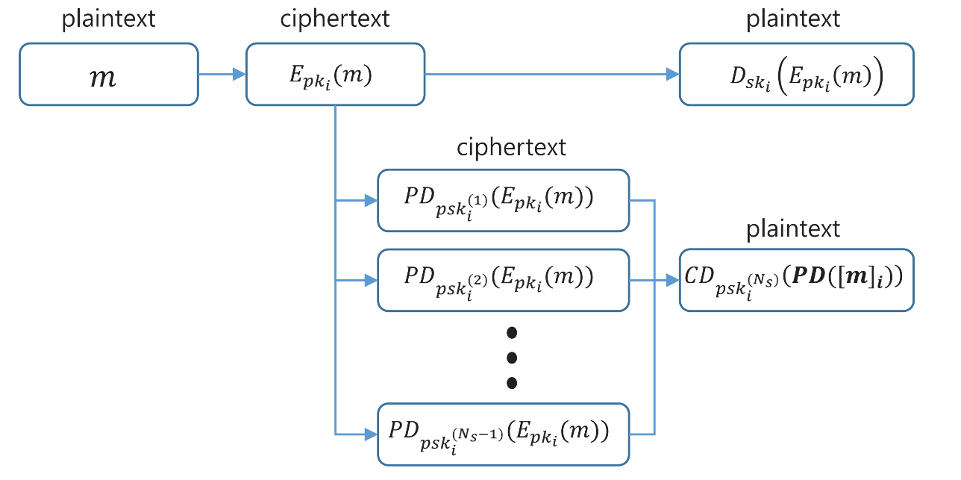
Introduction
1.3 Distributed Homomorphic Cryptosystem
Figure 1. Diagram for encryption, decryption, and partial decryption.

Slide 9
02
Methodology

Slide 10
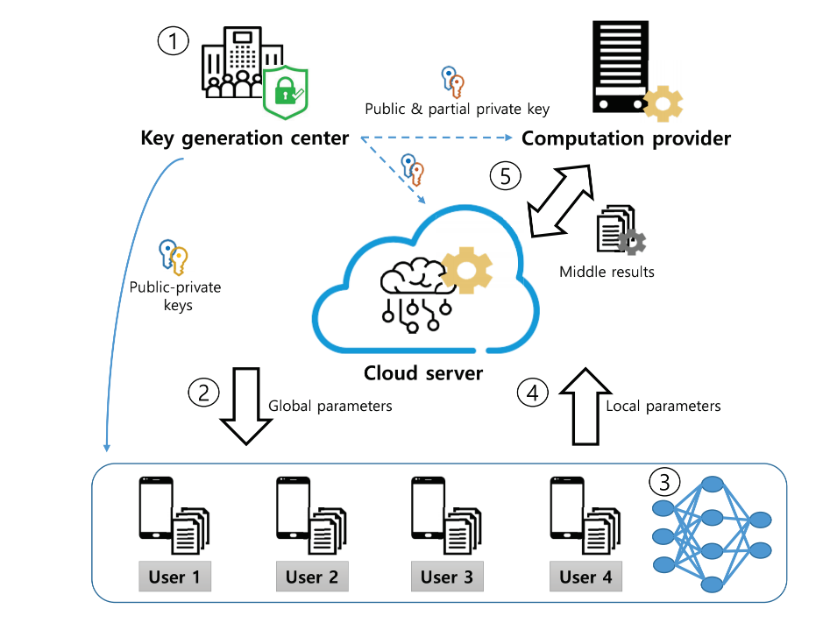
Methodology
3.1 System model
Figure 2. System model for privacy-preserving federated learning.

Slide 11
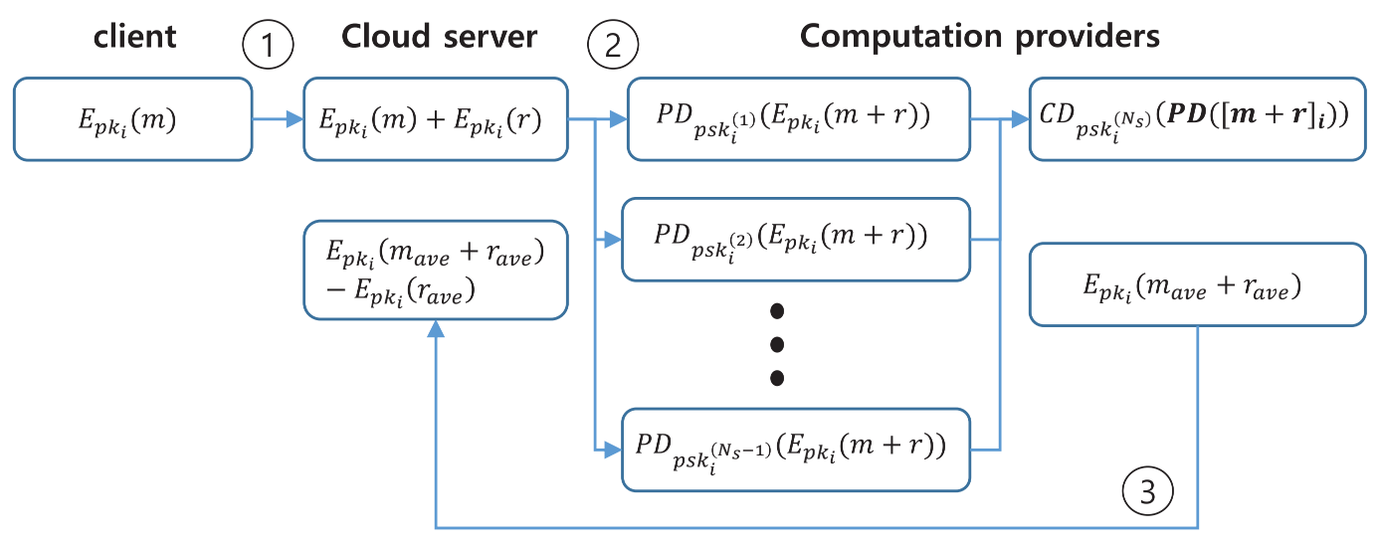
Methodology
3.2 System model
Figure 3. Diagram for secure averaging local model vector algorithm.

Slide 12
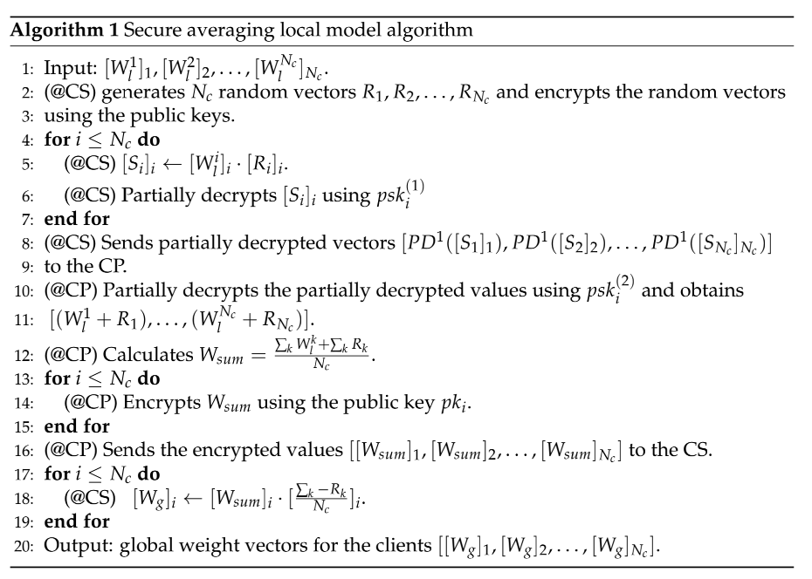
Methodology
3.2 Secure averaging local model algorithm

Slide 13
03
Conclusions

Slide 14
Conclusions
This paper proposes a privacy-preserving federated learning (PPFL) algorithm that allows a cloud server to update global model parameters by aggregating local parameters encrypted by different HE keys in the same FL-based system using homomorphic operations based on a distributed cryptosystem.

Slide 15
汇报完毕
Thanks for listening

